Slide 1
Microsoft Azure Training Day: Containerization & Orchestration on Azure

Slide 2
Goals for this session:
Containers & Orchestration: What, Why and How
Container Options on Azure
Kubernetes Service on Azure
Developer Experience

Slide 3
From traditional app to modern app
APP
Existing Application
Modern Infrastructure
Move to the cloud as VMs or Containers or refresh HW.
Modern Methodologies
Implement CI/CD and automation.
Containerize Applications
Re-architect apps for scale with containers.
Modern Microservices
Add new services or start peeling off services from monolithic code.
Notes:
Re-host
Re-factor
Re-Arch
Re-Build

Slide 4
What is container?

Slide 5
What is a Container?
Not a real thing. An application delivery mechanism with process isolation based on several Linux kernel features.
Namespaces (what a process can see)
PID
Mount
Network
UTS
IPC
User
Cgroup
Cgroups (what a process can use)
Memory
CPU
Blkio
Cpuacct
Cpuset
Devices
Net_prio

Slide 6
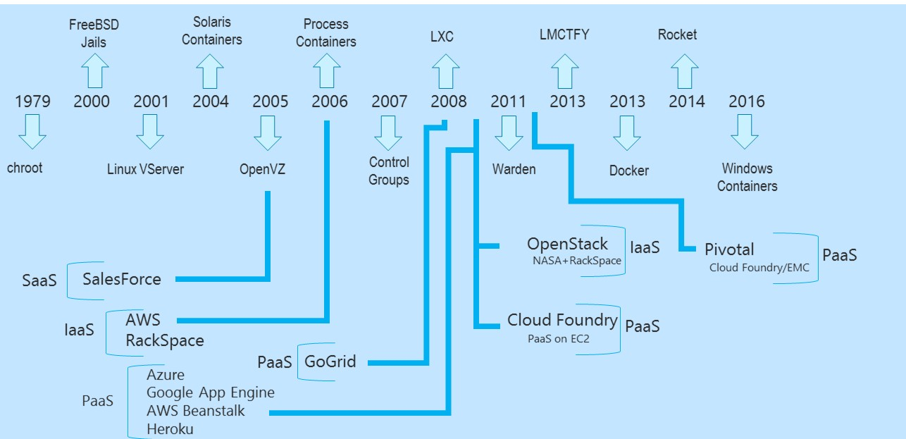
Container timeline

Slide 7


Docker Integration
Customer
Datacenter
Docker: An open source engine that automates the deployment of any application as a portable, self-sufficient container that can run almost anywhere
Partnership: Enable the Docker toolset to manage multi-container applications using both Linux and Windows containers, regardless of the hosting environment or cloud provider
Dockerized app
Windows Server
Container
Linux Container
Run anywhere
Microsoft
Azure
Service
Provider
Docker
Investments in the next wave of Windows Server
Open source development of the Docker Engine for Windows Server
Azure support for the Docker Open Orchestration APIs
Federation of Docker Hub images into the Azure Gallery and Portal
Strategic investments

Slide 8


Docker Integration
Docker Hub in Azure: Huge collection of open and curated applications available for download
Collaboration: Bring Windows Server containers to the Docker ecosystem to expand the reach of both developer communities
Docker Engine: Docker Engine for Windows Server containers will be developed under the aegis of the Docker open source project
Docker client: Windows customers will be able to use the same standard Docker client and interface on multiple development environments
Docker Client
Docker.exe
Examples:
docker run
docker images
Windows Server
Linux
Docker Remote API
Examples:
GET images/json
POST containers/create
Docker Engine
(Daemon)
Docker Engine
(Daemon)
Windows Server
Container Support
Linux Container
Support (LXC)

Slide 9

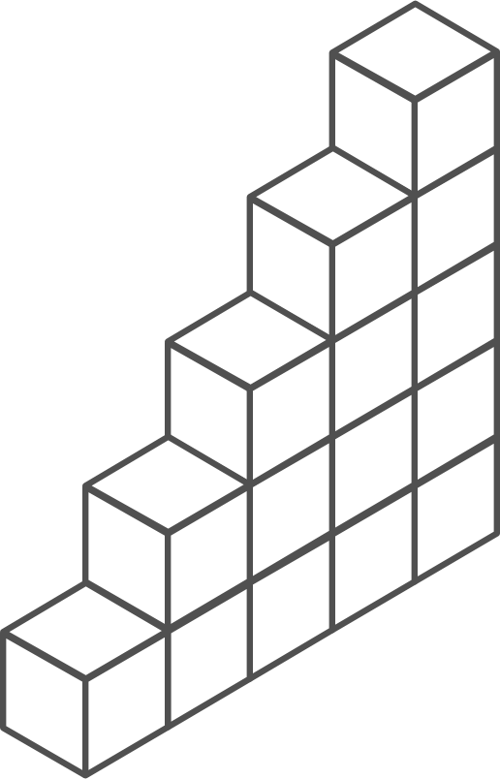
Containers and Kubernetes momentum
“By 2020, more than 50% of enterprises will run mission-critical, containerized cloud-native applications in production.”
Half of container environment is orchestrated.¹
77%
77% of companies² who use container orchestrators choose Kubernetes.
The average size of a container deployment has grown 75% in one year. ¹
Larger companies are leading the adoption.¹
75%
50%
Nearly 50% of organizations¹ running 1000 or more hosts have adopted containers.

Slide 10

Why containers?
Transforming Existing Applications into Cloud Applications
Is Hard!
Building Hybrid Cloud
Applications
Is Hard!

Slide 11
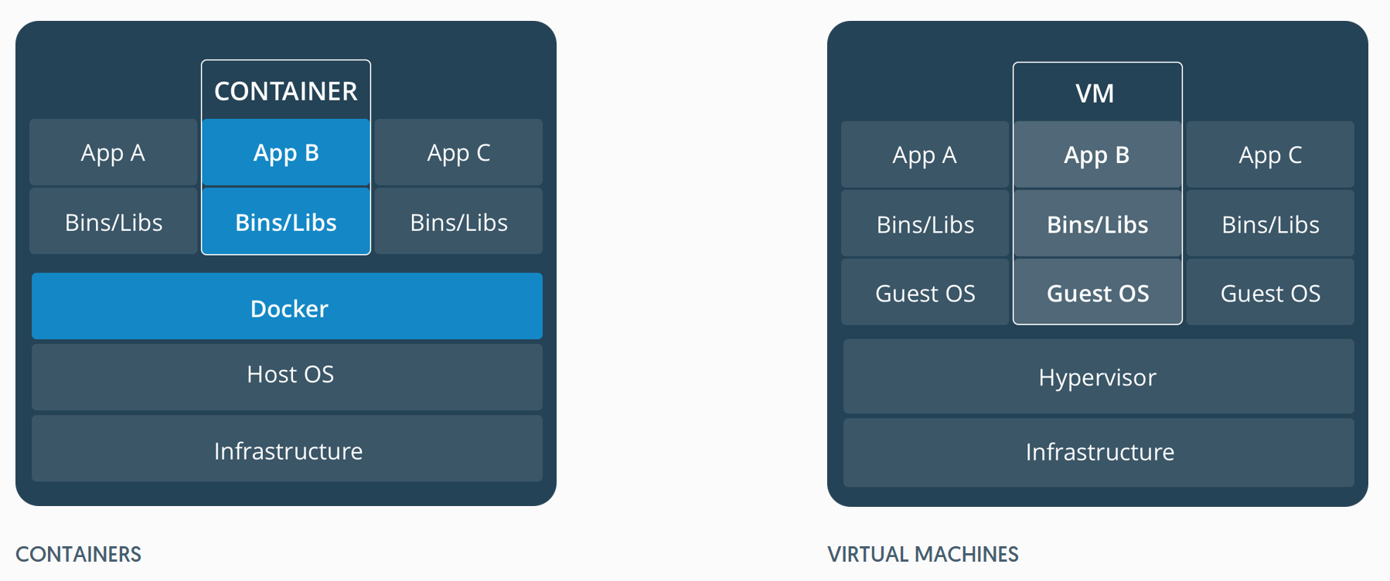
Containers vs. VMs

Slide 12

Image Anatomy
Image Contents
My Website
Registry
Folders and Files
Application
HKLM
inetpub
mysite.html
IIS
SOFTWARE/mykey
Application Framework
Image Contents
Registry
Folders and Files
HKLM
HKCU
License.txt
PerfLogs
Program Files
Base Image (OS)
HKCR
HKU
Program Files (x86)
Users
Windows

Slide 13
Dockerfile
FROM frolvlad/alpine-oraclejdk8:slim
VOLUME /tmp
ADD springbootreadinglistApp-0.0.1.jar app.jar
RUN sh -c 'touch /app.jar‘
ENV JAVA_OPTS="“
ENTRYPOINT [ "sh", "-c", "java $JAVA_OPTS -Djava.security.egd=file:/dev/./urandom -jar /app.jar" ]
0 B
913476jadbc
1.895 KB
12qw2g5623
176.7 KB
cc39y6rp526
192.50 KB
p9856bw270
192.5 KB
792tmnfw3t6
167.2 MB
niw39651i23r
Web App

Slide 14
Image layer sharing
0 B
0 B
913476jadbc
913476jadbc
1.895 KB
1.895 KB
12qw2g5623
12qw2g5623
176.7 KB
176.7 KB
cc39y6rp526
cc39y6rp526
192.50 KB
192.50 KB
p9856bw270
p9856bw270
192.5 KB
192.5 KB
792tmnfw3t6
792tmnfw3t6
167.2 MB
167.2 MB
niw39651i23r
niw39651i23r
Web App
Api

Slide 15
Windows Server Containers
Host User Mode
System Processes
Session Manager
Container Management
Local Security Authority
Windows Server Container
Windows Server Container
Docker Engine
Event Manager…
System Processes
Application Processes
System Processes
Application Processes
Compute Services
Etc…
Job Object
Net Interface
Storage
Registry
Job Object
Net Interface
Storage
Registry
Windows Kernel

Slide 16
Hyper-V Containers
Host User Mode
System Processes
Session Manager
Hyper-V Container
Container Management
Local Security Authority
Windows Server Container
Docker Engine
Guest Compute Service
Event Manager…
System Processes
Application Processes
Compute Services
Basic System Processes
Etc…
Job Object
Net Interface
Storage
Registry
Windows Kernel
Windows Kernel

Slide 17
Startup Performance
NodeJS with Nano Server
Windows Server Container
Under 600 Milliseconds!
Hyper-V Container
~1.75 seconds
A virtual machine takes ~3 seconds
NodeJS with Windows Server Core
Windows Server Container
~1 second
Hyper-V Container
~3.3 seconds
A virtual machine takes ~5 seconds to over a min

Slide 18
Image Registry
What is a registry?
Stores container images
Images are Pushed into a registry
Images are Pulled from a registry
Images are Searched for within a registry

Slide 19
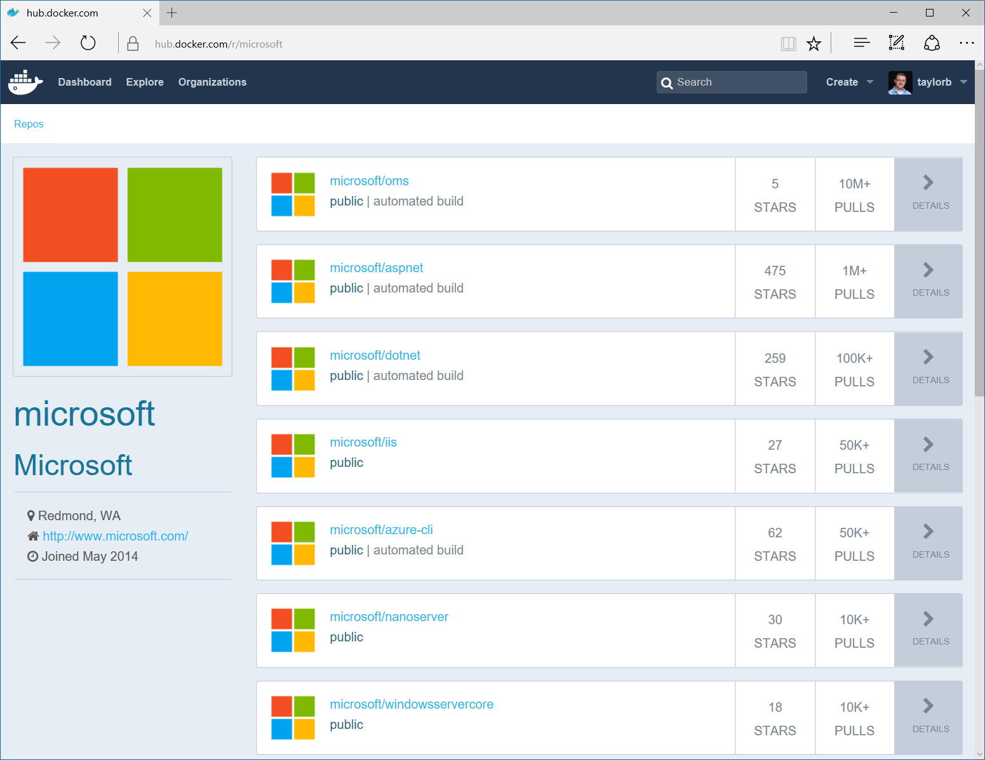
Image Registries
Docker Hub and Docker Store
Public, Official and Private image repositories
Granular access controls with organization support
Automated image build support
Docker Trusted Registry
Enterprise Grade Private Registries
Runs on your infrastructure (on-prem or cloud)
Active Directory and Role Based Access Controls
Docker Registry
Open source foundation of Hub and DTR
Runs on your infrastructure (on-prem or cloud) as a container
https://docs.docker.com/registry and or https://github.com/docker/distribution
Azure Container Registry (ACR)
Store your container image in local, network-close storage on Azure
Use Azure Active Directory to manage access
Manage Windows and Linux container images in a single registry

Slide 20
Azure Container Options

Slide 21







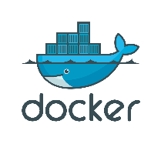
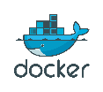



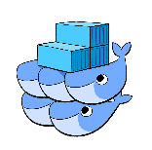


Our Approach to Open Source
Open and hybrid
Enable
Integrate
Release
Participate
Enable Linux and Open Source technology to be first class citizens on Microsoft Platforms
Embrace leading Open Source ecosystems and integrate Microsoft products with agility and consistency
Release key Microsoft technologies into the Open Source domain to build a strong ecosystem
Microsoft engineers to participate in communities and contribute to key Open Source projects
R Server
.NET Core
Roslyn
TypeScript
F#
autorest
PowerBI Visuals
Office UI Fabric
Tools plugins
Open Source Partners & Ecosystem

Slide 22
Microsoft contributes open source containers
#2 overall individual contributor to Kubernetes (Brendan Burns)
#4 overall individual contributor to Docker (John Howard)
#1-3 overall individual contributors to Helm
70 Microsoft employees have made contributions to Kubernetes

Slide 23






















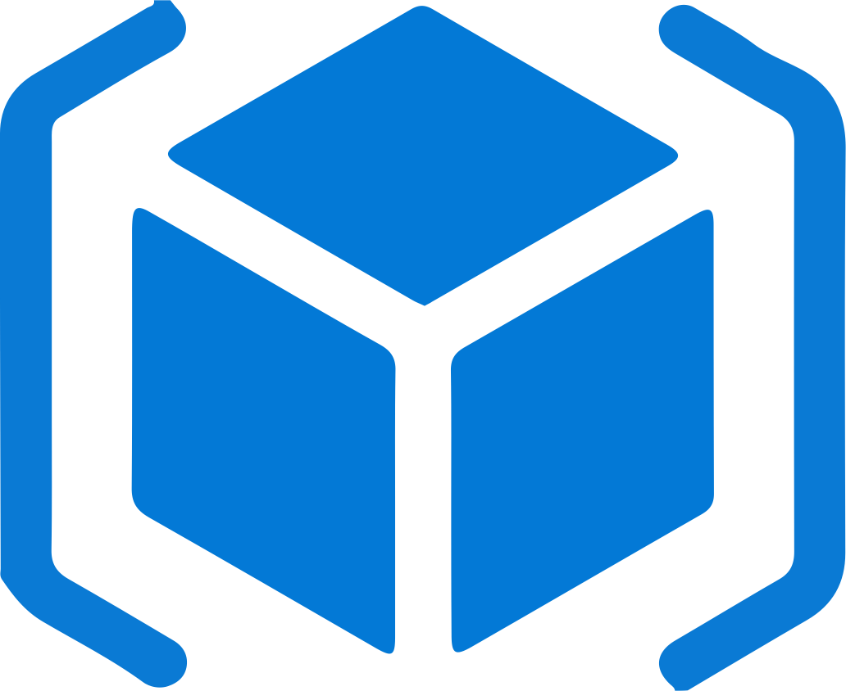

Work how you want with opensource tools and APIs
 | Development | DevOps | Monitoring | Networking | Storage | Security
Take advantage of services and tools in the Kubernetes ecosystem
…or… Leverage growing Azure support
RBAC
Azure Container Registry
AAD
Key Vault
Azure DevOps
ARM
VS Code
Azure Monitor
Azure VNET
Azure Storage

Slide 24
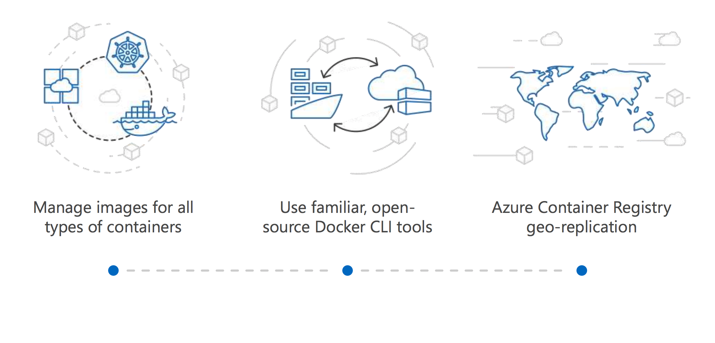
Azure Container Registry (ACR)
Manage a Docker private registry as a first-class Azure resource
GA of Azure Container Registry Geo Replication
Single registry/image/tag names can be used across multiple regions
Network-close registry access from regional deployments
Keep container images near deployments to reduce latency and costs
Single management of a registry across multiple regions
Helm chart repositories integration (preview)
GA Announcement Blog

Slide 25
Three Different Ways To Build Containers
docker build; docker push*
az acr build*
Azure DevOps Pipeline
*manual

Slide 26
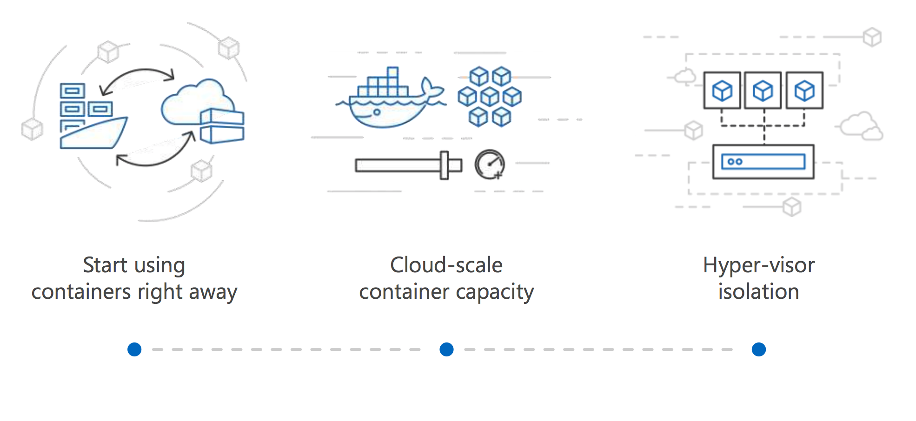
Azure Container Instances
Azure Container Instances (ACI)
Serverless Containers
GA (Windows and Linux)
Preview of AKS and ACI
Benefits:
Fastest and easiest way to run a container in the cloud
No VM management
Per-GB, Per-CPU, and Per-second billing
Deploy images from DockerHub or Azure Container Registry
Allows customers to opt-in to having the Azure Container Instances connector configured in their AKS cluster, without having to set it up themselves. The ACI connector enables customers to deploy additional container capacity for their AKS cluster using ACI.
https://azure.microsoft.com/en-us/blog/azure-container-instances-now-generally-available/

Slide 27
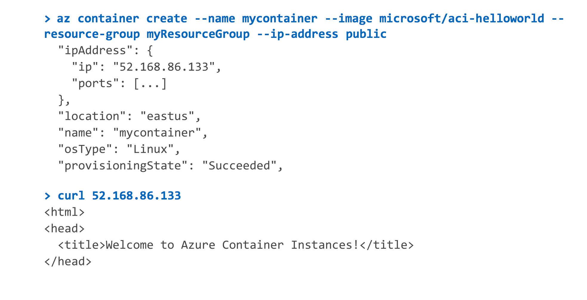
Azure Container Instances
Azure Container Instances (ACI)
Get started easily

Slide 28

Azure App Service
Fully Managed Application Platform
Deploy your stack natively or with containers (Node, PHP, .NET, Python)
Support custom domains, SSL certificates, single sign-on
Plug into Azure’s wide variety of services
Load Balancing
CI/CD
Managed Databases

Slide 29
Azure App Service
Continuous Delivery based on code changes or container pushes
High Availability with multi-region deployments and autoscaling
Azure Monitor provides detailed views of resource usage, while Application Insights provides deeper insights into your app’s throughput, response times, memory/CPU utilization, and error trends.

Slide 30
Deploying to Azure App Service
az webapp create \
-g $RES_GROUP \
-n $WEB_APP_3 \
--plan $APP_SERVICE \
--deployment-container-image-name 'nginx'

Slide 31
But what if I need…
Auto-scaling
Rolling upgrades
Service discovery
Integrated load balancing
Affinity/anti-affinity
ReadingList web App
Azure Storage(Images)
MySQL
Recommendation service

Slide 32
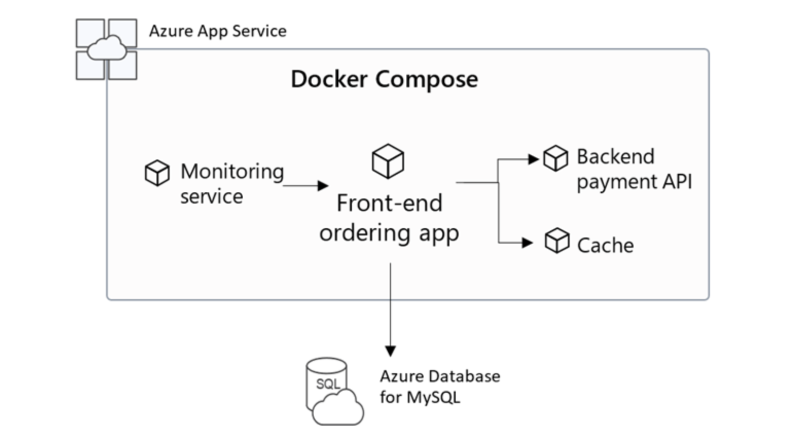
App Service(Linux): Multi-container support
Single VM host
No orchestration overhead
Deploy via
Docker Compose
Kubernetes Pod definition (.yml)
Deploy into VNet (ASE)
Windows Container support (private preview)

Slide 33
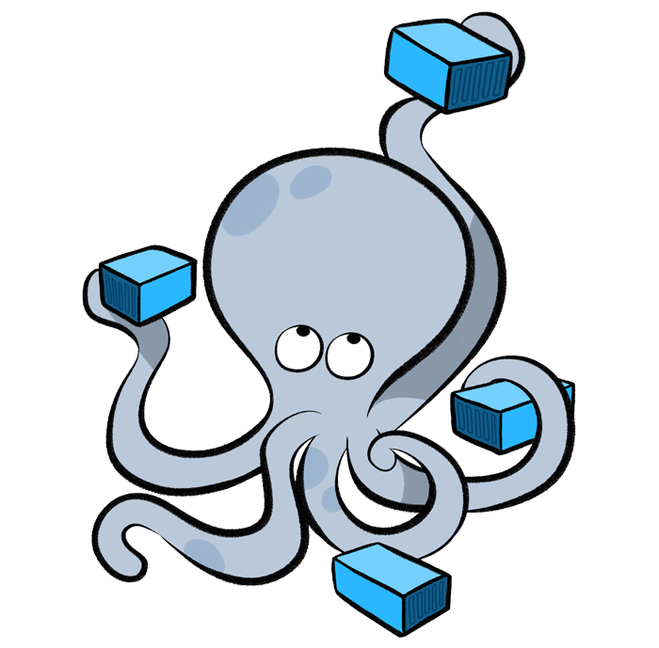
Composition and Orchestration
Applications typically comprised of multiple containers
Containers typically hosted across a cluster of nodes
Orchestration tooling automates this

Slide 34
Kubernetes: the industry leading orchestrator
Portable
Public, private, hybrid, multi-cloud
Extensible
Modular, pluggable, hookable, composable
Self-healing
Auto-placement, auto-restart, auto-replication, auto-scaling

Slide 35
Kubernetes 101
Internet
Kubernetes users communicate with API server and apply desired state
Kubernetes control
Worker node
kubelet
kube-proxy
Master nodes actively enforce desired state on worker nodes
Master node
Docker
Prod
Prod
API server
Containers
Containers
Worker nodes support communication between containers
-controller-manager
-scheduler
Worker node
kubelet
kube-proxy
Worker nodes support communication from the Internet
replication, namespace, serviceaccounts, etc.
etcd
Docker
Prod
Prod
Containers
Containers

Slide 36
How managed Kubernetes on Azure works
Azure managed control plane
Automated upgrades, patches
High reliability, availability
Easy, secure cluster scaling
Self-healing
API server monitoring
At no charge
App/ workload definition
Self-managed master node(s)
Kubernetes API endpoint
etcd Store
User
API server
Scheduler
Controller Manager
Cloud Controller
Schedule pods over private tunnel
Customer VMs
Docker
Docker
Docker
Docker
Docker
Pods
Pods
Pods
Pods
Pods

Slide 37
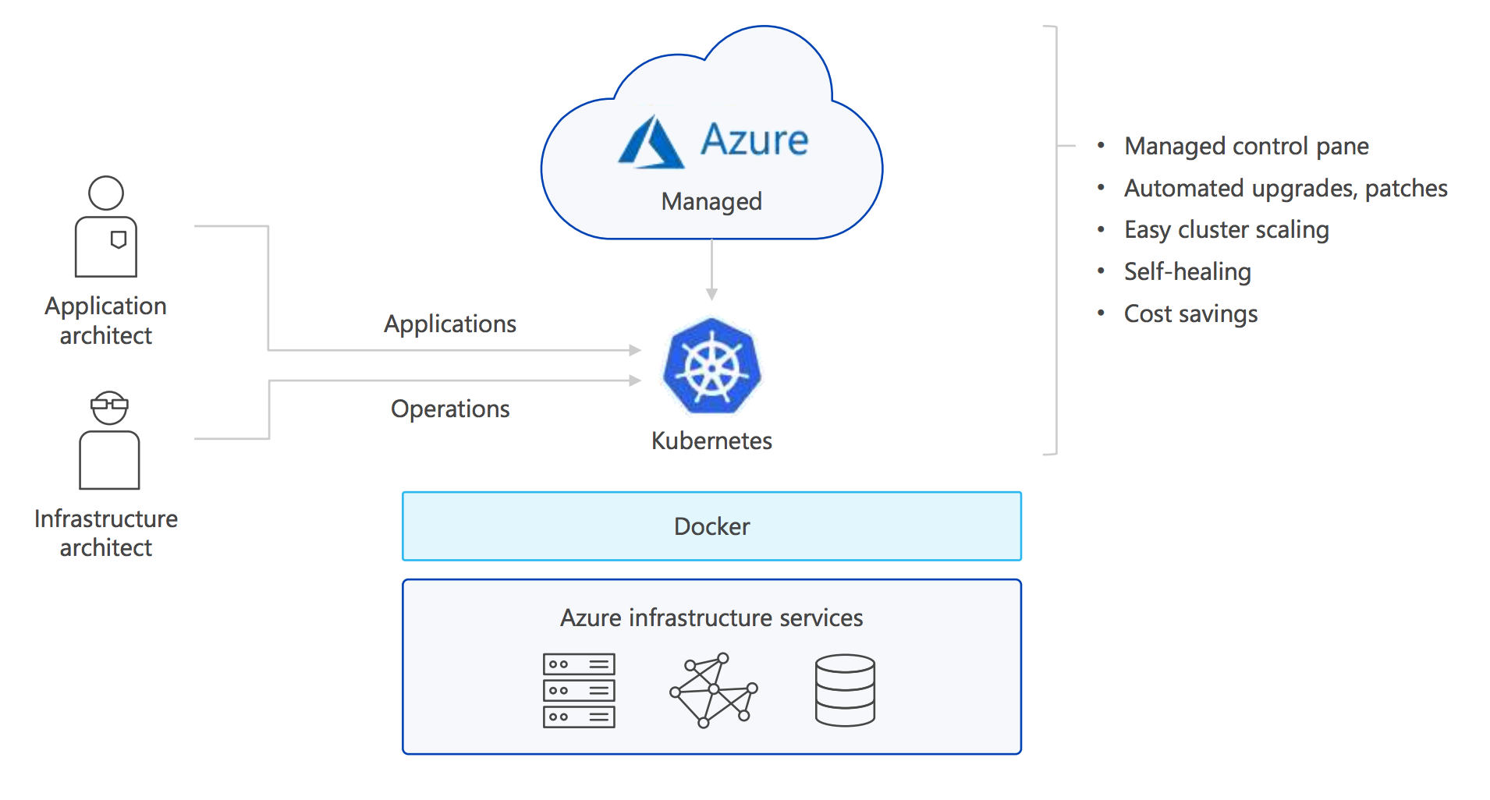
Azure Kubernetes Service (AKS) A fully managed Kubernetes cluster
Simplify the deployment, management, and operations of Kubernetes
Easily manage clusters without container expertise
No per-cluster charge. Only pay for resources consumed.
Healing, auto-scaling, load balancing
Reliable, zero-downtime rollout of software versions
OSBA pre installed option enables customers to use the Open Service Broker for Azure with the Azure Container Service without having to first set it up.
VNet integration option
Windows Containers Support (preview)

Slide 38
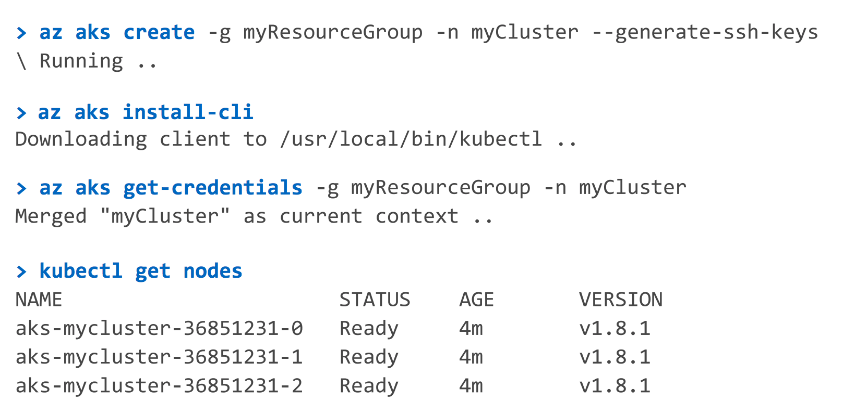
Azure Kubernetes Service (AKS) Get started easily

Slide 39
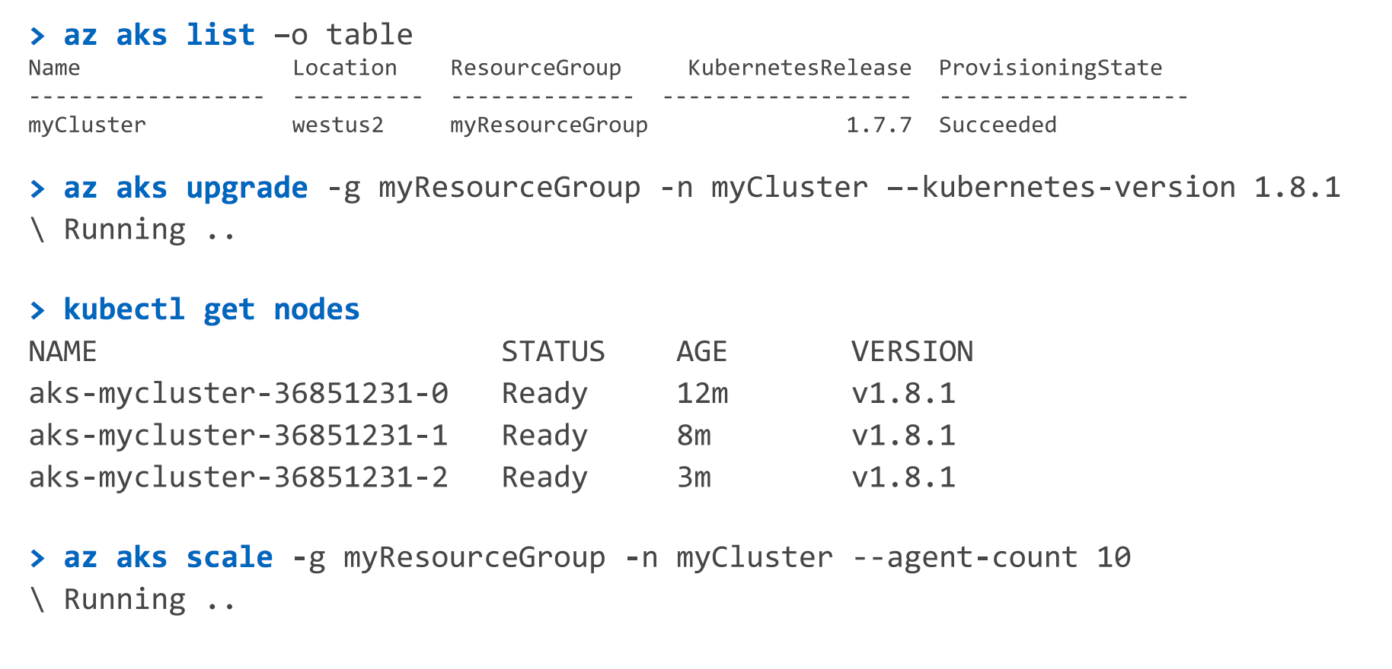
Azure Kubernetes Service (AKS) Manage an AKS cluster

Slide 40
From infrastructure to innovation
Managed Kubernetes empowers you to do more
Focus on your containers and code, not the plumbing of them
Responsibilities | DIY with Kubernetes | Managed Kubernetes on Azure
Containerization
Application iteration, debugging
CI/CD
Cluster hosting
Cluster upgrade
Patching
Scaling
Monitoring and logging
Customer
Microsoft

Slide 41
Azure makes Kubernetes easy
Deploy and manage Kubernetes with ease
Task | The old way | With Azure
Create a cluster | Provision network and VMs Install dozens of system components including etcd Create and install certificates Register agent nodes with control plane | az aks create
Upgrade a cluster | Upgrade your master nodes Cordon/drain and upgrade worker nodes individually | az aks upgrade
Scale a cluster | Provision new VMs Install system components Register nodes with API server | az aks scale

Slide 42
Secure your Kubernetes environment
Control access through AAD and RBAC
Safeguard keys and secrets with Key Vault
Secure network communications with VNET and CNI
Compliant Kubernetes service with certifications covering SOC, HIPAA, and PCI

Slide 43
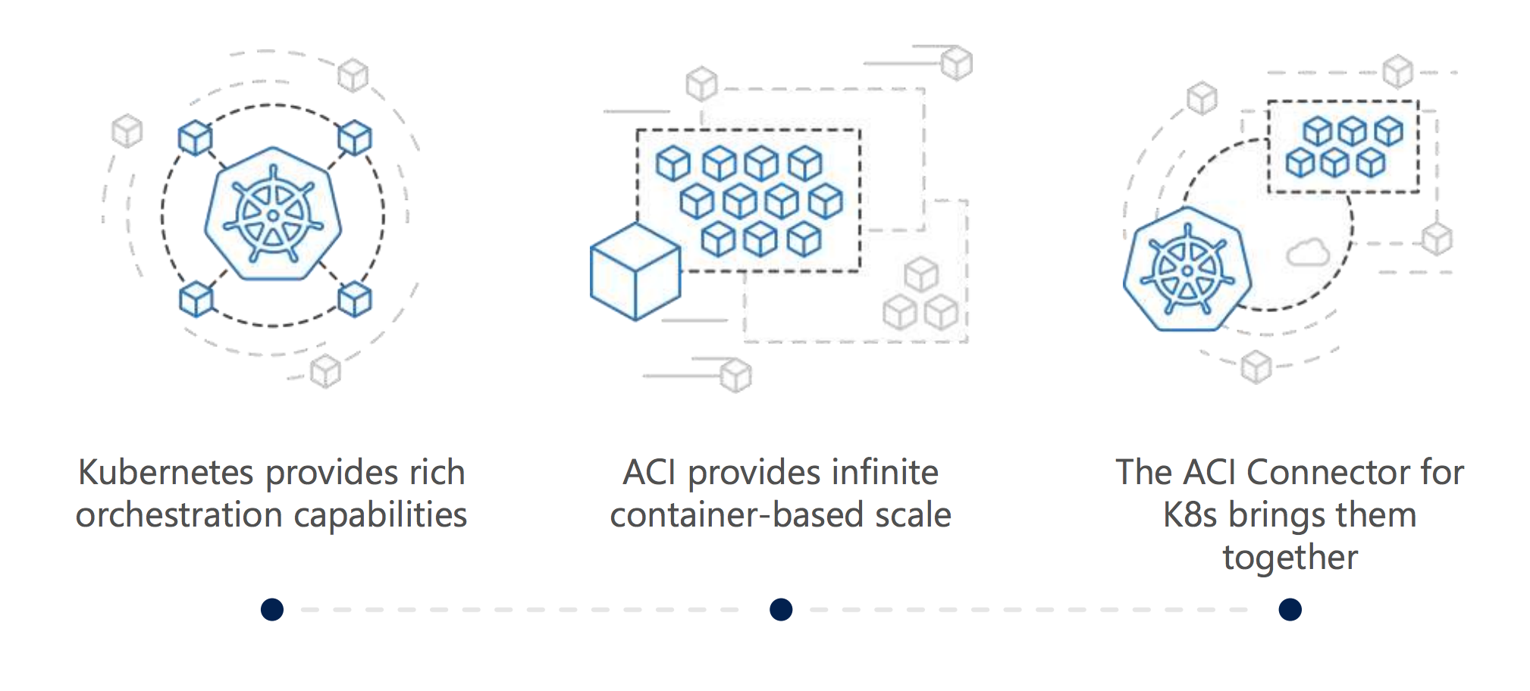
ACI Connector for Kubernetes aka “Virtual Kubelet”

Slide 44
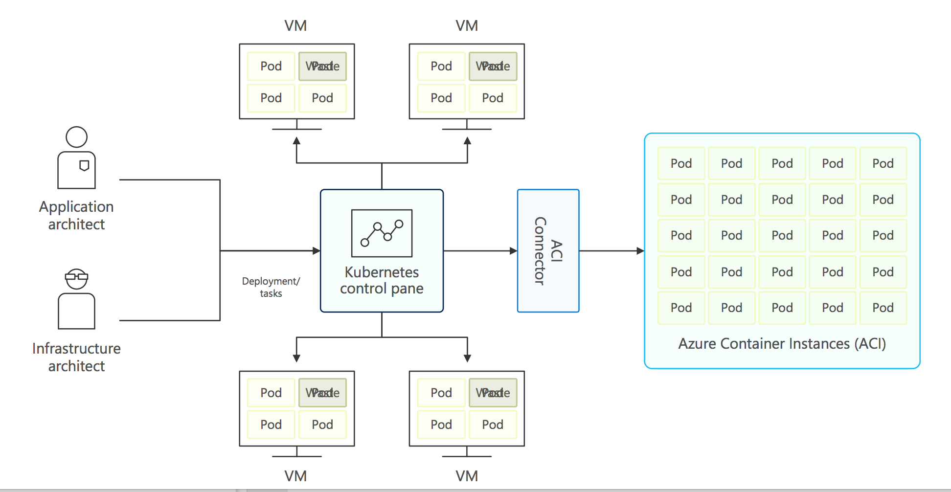
Bursting with the ACI Connector

Slide 45


Scale and run with confidence
Built-in auto scaling
Global data center
Elastically burst using ACI
Geo-replicated container registry
Geo-replicated container registry
Azure Container Instances
Pod
Pod
Pod
Pod
AKS clusters
Traffic manager
Browser
Pod
Pod

Slide 46




Architectural approach
App Gateway
Azure Pipelines for automation and CI/CD pipelines; adding Terraform for further automation
Firewall
Azure Pipeline
AKS w/ RBAC
Data Factory
Data Management Gateway
On-premises database
Key Vault to secure secrets and for persistent configuration store
1
4
Express Route
Key Vault
SQL Database
Azure Monitor for containers provides better logging, troubleshooting, with no direct container access
2
SQL Database
Cosmos DB
Azure Monitor
Event Hub
3
Performance Document DB
RBAC control for fine grained Kubernetes resources access control
Batch processing
Event Simulation
Service Bus
Internal Queuing

Slide 47
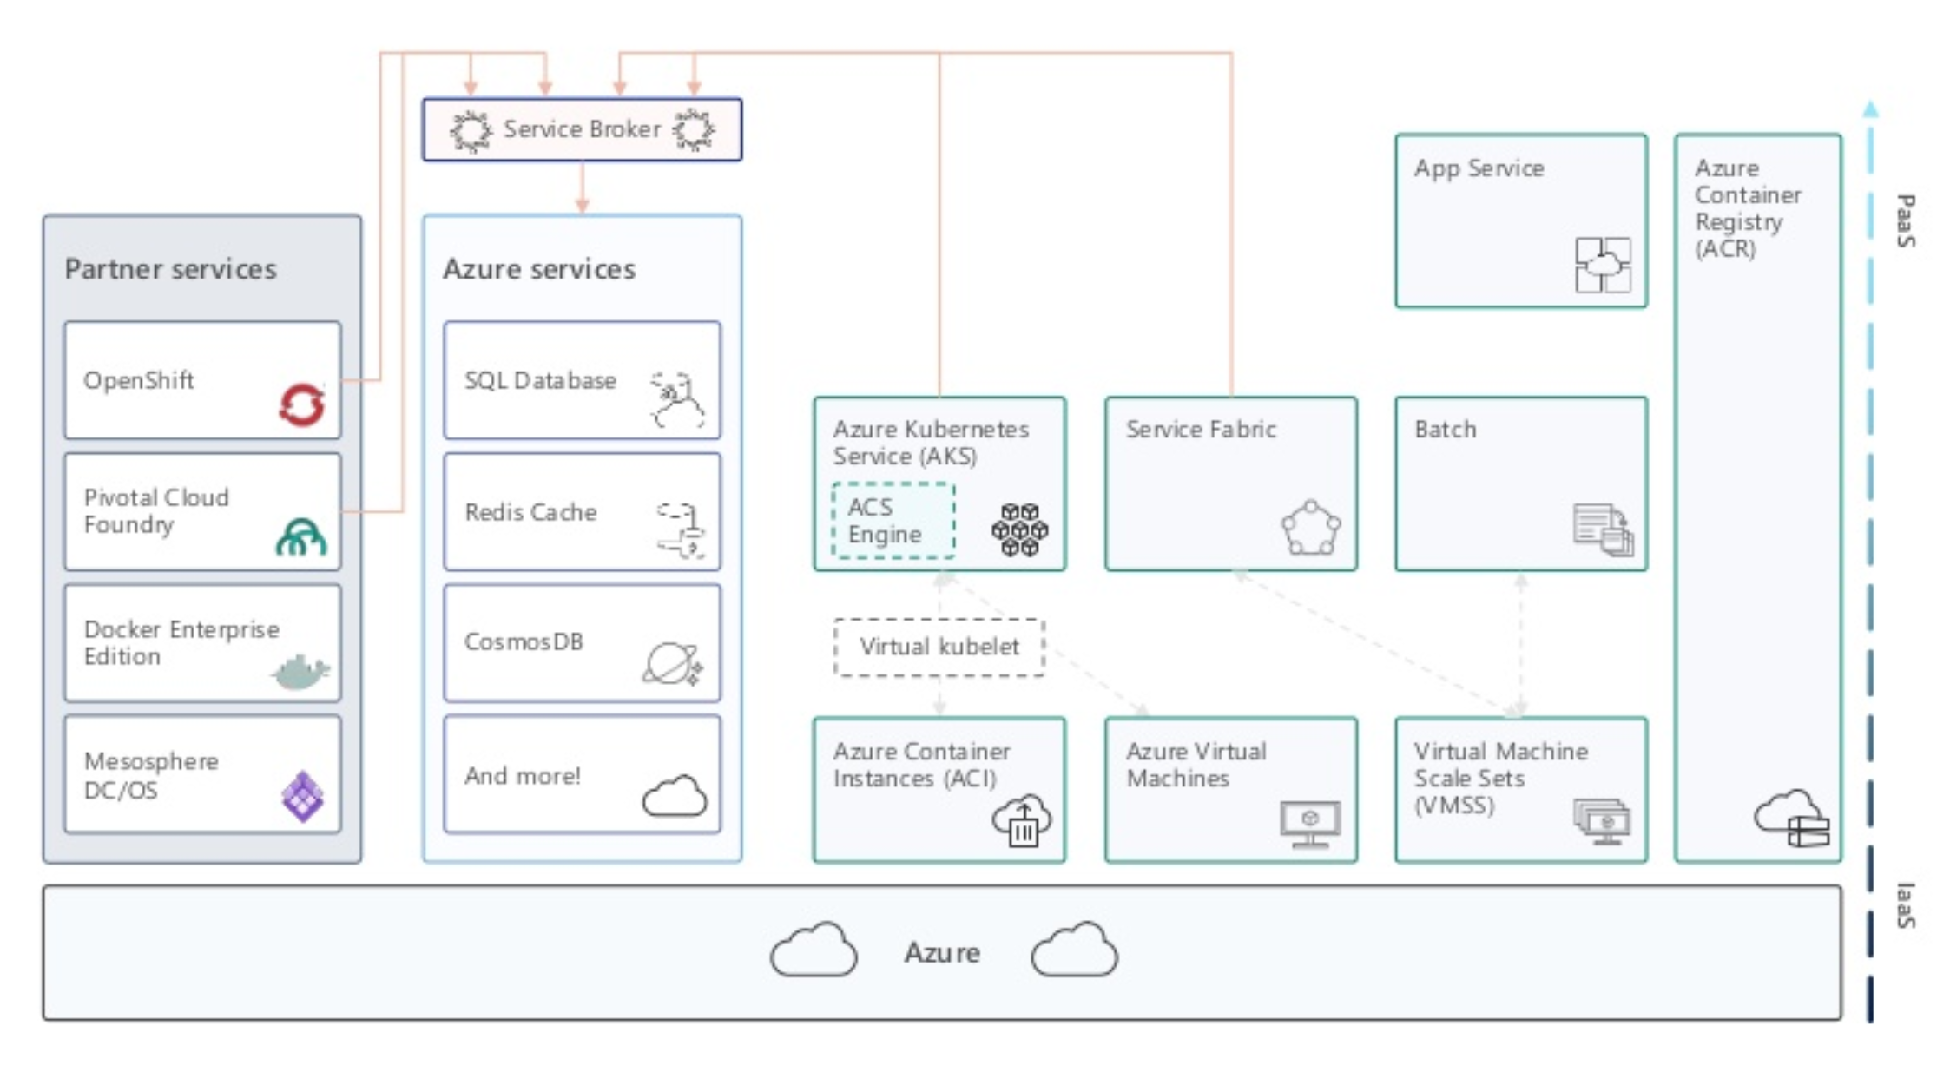
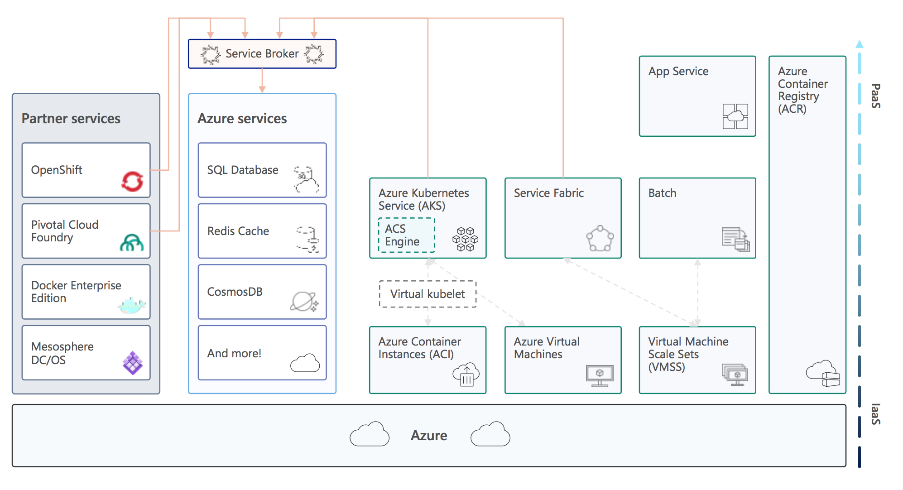
Container Deployment Options

Slide 48


What about security? A dramatically larger attack surface
CONTAINER
Attack surface
VM
Continuous deployment
Dev cycles
Infrequent, major releases
10x per host, weeks/months
1000x per host, hours/days
Scale
Few apps, few nodes
Connectivity
Dozens of interconnected micro services

Slide 49
Developing Kubernetes Applications
Notes:
az container create --name helloworld –g cs612aci --image microsoft/aci-helloworld --ip-address public

Slide 50

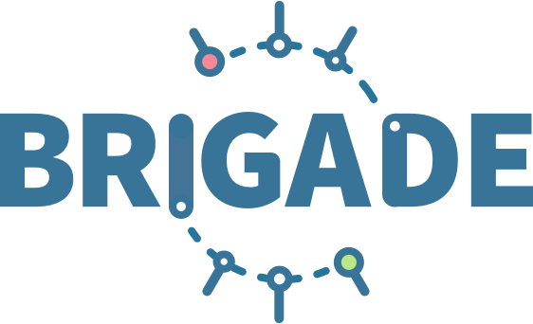



Release automation tools
Azure Container Service (AKS)
Simplifying the Kubernetes experience
Azure Container Instances (ACI)
Azure Container Registry
Open Service Broker API (OSBA)
Streamlined Kubernetes development
The package manager for Kubernetes
Event-driven scripting for Kubernetes
Visualization dashboard for Brigade
Release Automation Tools

Slide 51
Helm
Azure Container Service (AKS)
The best way to find, share, and use software built for Kubernetes
Azure Container Instances (ACI)
Azure Container Registry
Manage complexity
Charts can describe complex apps; provide repeatable app installs, and serve as a single point of authority
Easy updates
Take the pain out of updates with in-place upgrades and custom hooks
Simple sharing
Charts are easy to version, share, and host on public or private servers
Rollbacks
Use helm rollback to roll back to an older version of a release with ease
Open Service Broker API (OSBA)
Release Automation Tools

Slide 52

Helm
Azure Container Service (AKS)
Helm Charts helps you define, install, and upgrade even the most complex Kubernetes application
Azure Container Instances (ACI)
services
ci
db
load balancer
custom
Azure Container Registry
…
Chart.yml
Open Service Broker API (OSBA)
Release Automation Tools

Slide 53
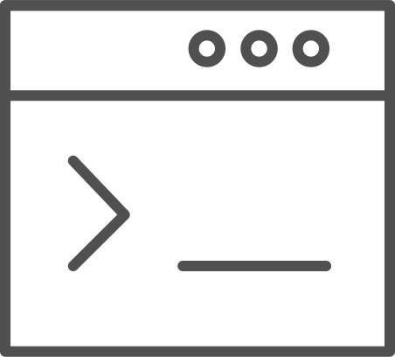
Draft
Azure Container Service (AKS)
Simple app development and deployment – into any Kubernetes cluster
Azure Container Instances (ACI)
Azure Container Registry
Open Service Broker API (OSBA)
Simplified development
Using two simple commands, developers can now begin hacking on container-based applications without requiring Docker or even installing Kubernetes themselves
Language support
Draft detects which language your app is written in, and then uses packs to generate a Dockerfile and Helm Chart with the best practices for that language
Release Automation Tools

Slide 54
Collaborate within a development team with Azure Dev Spaces
Share an AKS cluster for team development
Test code end-to-end without replicating or simulating dependencies
Onboard new team members with minimal machine setup

Slide 55



Fast, iterative development for cloud native apps
Light yellow
Yellow (Primary brand color)
Light blue
Iterate fast, directly in Azure
AKS
with Dev Spaces
Blue (Primary brand color)
Red (Primary accent color)
Dark red
Mid blue
Light orange
Dark blue
Commit code
Deploy
Edit content (html, css, cshtml)
Update file directly in running container
Orange (Primary brand color)
Edit server code
Restart node service, .NET build/run
Edit Dockerfile, Helm chartpackage.json...
SCC => CI/CD
Rebuild container image, redeploy

Slide 56
Collaborate within a development team
http://myapp.aksapps.io
WebFrontEnd
MyWebApi (Susie’s version)
MyWebApi
OtherService

Slide 57

Collaborate within a development team
http://myapp.aksapps.io
WebFrontEnd
MyWebApi
OtherService
http://susie.s.myapp.aksapps.io
MyWebApi (Susie’s version)
Susie Walter

Slide 58





End to end experience
Helm chart
AKS production cluster
Front end
Inner loop
Azure Container Registry
Source code control
Azure Monitor
Azure DevSpaces
AKS dev cluster
Test
Business logic
Debug
Auto-build
Azure Pipelines/ DevOps Project
Database tier
CI/CD

Slide 59
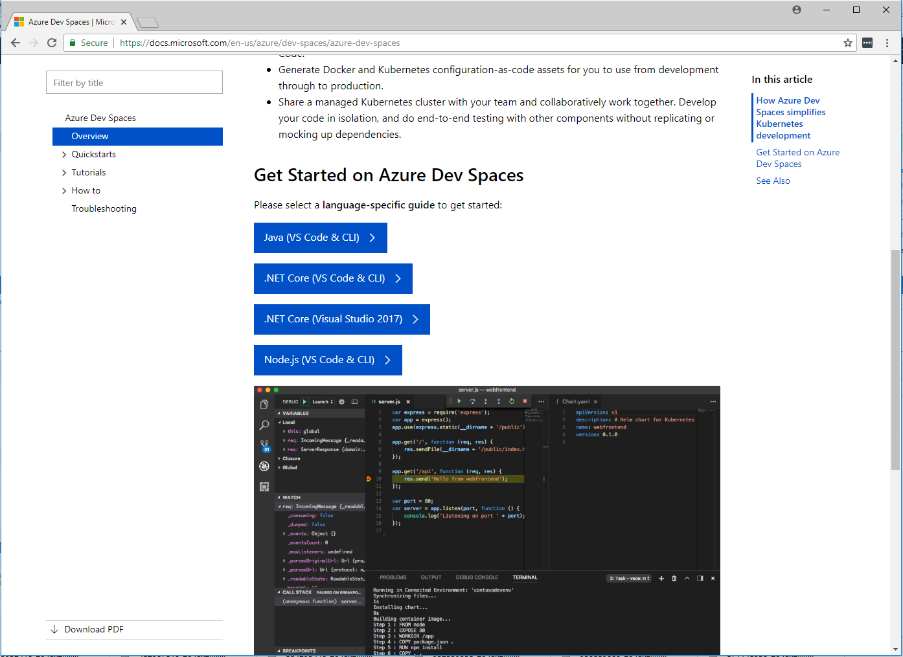

Resources
Get started with Azure Dev Spaces
http://aka.ms/get-azds

Slide 60
Demo
Notes:
“0 to K8s in 60 seconds (ish)” - you will need a pre-provisioned AKS/ACR
Scaffold an application of choice (recommend node, quick to build and start)
https://expressjs.com/en/starter/generator.html
Draft create
Draft up
This will take ~30s. Show and explain what draft has done:
Dockerfile
Helm charts
Draft connect
Time permitting:
Make a code change and draft up
Show helm history
Helm Rollback

